Slide 1
Fault Tolerance
Introduction
Process Resilience
Distributed Commit
Recovery

Slide 2
Fault Tolerance
Introduction

Slide 3
What are different ways distributed systems may suffer ?
a) Failure of a link
b) Failure of a site
c) Loss of message
d) Failure of power
What are important steps followed when recovery from failure happens ?
a) Post repairing integration with main system should happen smoothly and gracefully
b) Upon link failure both parties at end must be notified
c) Fault recovery system must be adjusted
d) Failures are logged systematically

Slide 4
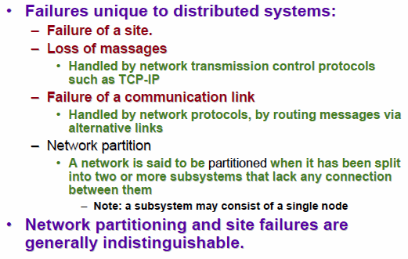
Dept. of CSE, IIT KGP
System Failure Modes

Slide 5

Which of the following approaches are used to achieve reliable systems?
a) Fault prevention
b) Fault removal
c) Fault tolerance
d) All of the mentioned

Slide 6
Fault Tolerance
A DS should be fault-tolerant
  Should be able to continue functioning in the presence of faults
Fault tolerance is related to dependability

Slide 7
Dependability
Dependability Includes
Availability
Reliability
Safety
Maintainability

Slide 8
Availability & Reliability (1)
Availability: A measurement of whether a system is ready to be used immediately
  System is up and running at any given moment
Reliability: A measurement of whether a system can run continuously without failure
  System continues to function for a long period of time

Slide 9
Availability & Reliability (2)
A system that never crashes but is shut down for a week once every year is 100% reliable but only 98% available
A system goes down 1millisec/hr has an availability of more than 99.99%, but is unreliable

Slide 10
Safety & Maintainability
Safety: A measurement of how safe failures are
  System fails, nothing serious happens
  For instance, high degree of safety is required for systems controlling nuclear power plants
Maintainability: A measurement of how easy it is to repair a system
  A highly maintainable system may also show a high degree of availability
  Failures can be detected and repaired automatically Self-healing systems

Slide 11
Exception handling is a type of
a) forward error recovery mechanism
b) backward error recovery mechanism
All fault-tolerant techniques rely on
a) Integrity
b) Dependability
c) Redundancy
A system maintaining its integrity while accepting a temporary halt in its operation is said to be in a state of
a) Full Fault Tolerance
b) Graceful Degradation
c) Fail Soft
d) Fail Safe

Slide 12
Faults
A system fails when it cannot meet its promises (specifications)
An error is part of a system state that may lead to a failure
A fault is the cause of the error
Fault-Tolerance: the system can provide services even in the presence of faults
Faults can be:
  Transient (appear once and disappear)
  Intermittent (appear-disappear-reappear behavior)
    A loose contact on a connector ➔intermittent fault
  Permanent (appear and persist until repaired)

Slide 13
Failure Models
Type of failure | Description
Crash failure | A server halts, but is working correctly until it halts
Omission failure Receive omission Send omission | A server fails to respond to incoming requests A server fails to receive incoming messages A server fails to send messages
Timing failure | A server's response lies outside the specified time interval
Response failure Value failure State transition failure | The server's response is incorrect The value of the response is wrong The server deviates from the correct flow of control
Arbitrary failure (Byzantine failure) | A server may produce arbitrary responses at arbitrary times

Slide 14
Consider two communication services for use in asynchronous distributed Systems. In service A
Messages may be lost duplicated
Or delayed and Checksums apply only to headers.In service B messages may be Lost delayed or delivered too fast for the recipient to handle them but those that are delivered arrive ordered and
with the correct contents_x0001_
Describe the classes of failure
exhibited by each service_x0001_
Classify their failures according
to their effect on properties of validity and integrity
Can service B be described as a reliable communication service?
Consider two communication services for use in asynchronous distributed Systems. In service A, messages may be lost duplicated or delayed and Checksums apply only to headers. In service B, messages may be lost, delayed or delivered too fast for the recipient to handle them but those that are delivered arrive ordered and
with the correct contents
Describe the classes of failure exhibited by each service
Classify their failures according to their effect on properties of validity and integrity
Can service B be described as a reliable communication service?

Slide 15
Consider a simple server that carries out clients requests without accessing other servers. Why it is generally not possible to set a limit on the time taken by such a server to respond to a client request? What would need be done to make the server able to execute requests within a bounded time?

Slide 16
Consider two communication services for use in asynchronous distributed Systems. In service A
Messages may be lost duplicated
Or delayed and Checksums apply only to headers.In service B messages may be Lost delayed or delivered too fast for the recipient to handle them but those that are delivered arrive ordered and
with the correct contents_x0001_
Describe the classes of failure
exhibited by each service_x0001_
Classify their failures according
to their effect on properties of validity and integrity
Can service B be described as a reliable communication service?
We cannot send a limit for the time taken by a server to respond a client request because the arrival of client requests is not predictible. For example, we can have limits for executing a computation corresponding to a request but we can not predict how much a request will have to wait until its execution time arrives_x0001_

Slide 17
Failure Masking
Redundancy is key technique for hiding failures
Redundancy types:
Information: add extra (control) information
  Error-correction codes in messages
Time: perform an action persistently until it succeeds:
  Transactions
Physical: add extra components (S/W & H/W)
  Process replication, electronic circuits

Slide 18
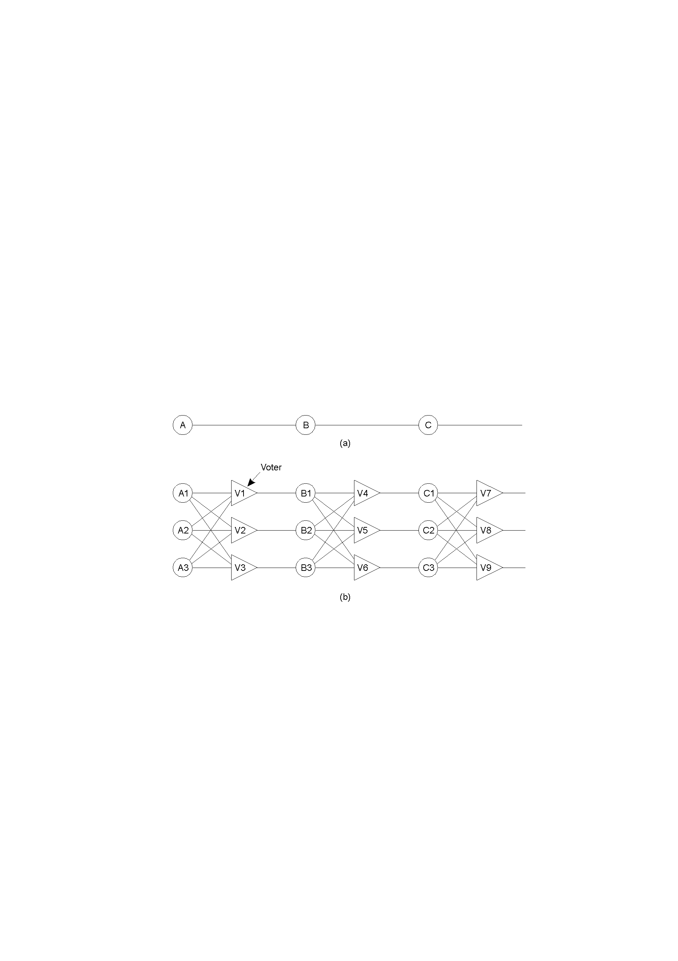
Example – Redundancy in Circuits (1)

Slide 19
Example – Redundancy in Circuits (2)
Triple modular redundancy.

Slide 20
A Web browser returns an outdated cached page instead of a more recent one that had been updated at the server.
Is this a failure, and if so, what kind of failure?

Slide 21
Whether or not it is a failure depends on the consistency that was promised to the user.
If the browser promises to provide pages that are at most T time units old, it may exhibit performance failures. However, a browser can never live up to such a promise in the Internet.
A weaker form of consistency is to provide one of the client-centric models. In that case, simply returning a page from the cache without checking its consistency may lead to a response failure.

Slide 22
Fault Tolerance
Process Resilience

Slide 23
Process Resilience
Mask process failures by replication
Organize identical processes into groups, a message sent to a group is delivered to all members
If a member fails, another can take over it

Slide 24
Process Replication for Failure Masking
A system is k fault-tolerant if it can survive and function even if it has k faulty processes
  For crash failures (a faulty process halts, but is working correctly until it halts) replicas required:
  For Byzantine failures (a faulty process may produce arbitrary responses at arbitrary times) replicas :
k+1
2k+1

Slide 25
Process Groups
Examples of some group applications
Replicated file systems: All file servers constitute a group. Files are replicated at every fileserver to enhance file availability and reliability
Replicated program executions for the resiliency of computations.
Notes:
Programs can be decomposed into abstract data type modules, each having a set of internal states and a set of procedures manipulating the states.
Modules are replicated on multiple sites and replicas of a module form a group.

Slide 26
Process Groups
A distributed database model has a transaction manager (TM) and a data manager (DM) on each site.
Each TM accepts user requests and translates them into commands for DMs. Each DM maintains part of the database stored at its site and may concurrently execute transactions from multiple TMs.
A transaction group consists of all DMs participating in the same transaction.

Slide 27
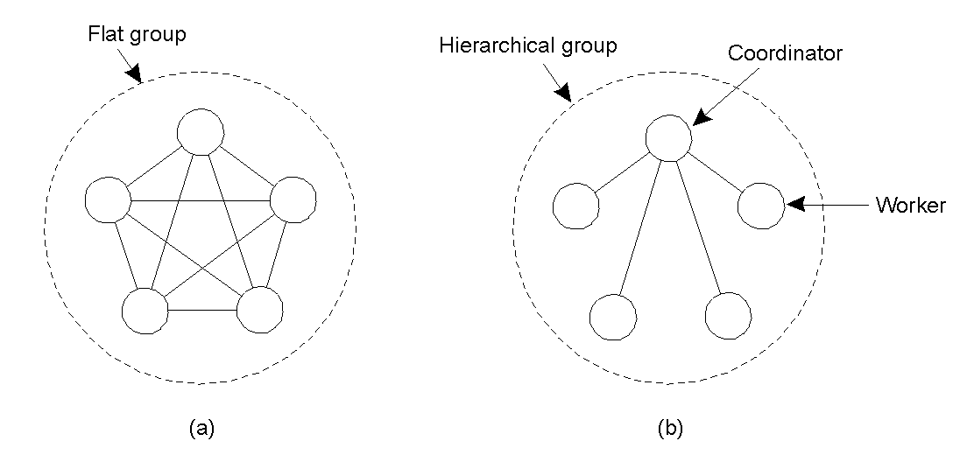
Flat Groups versus Hierarchical Groups
Communication in a flat group.
Communication in a simple hierarchical group
Advantage and Limitation of each ?

Slide 28
Fault Tolerance
Reliable Group Communication

Slide 29
Reliable Group Communication
Reliable multicast: message sent to a group must be delivered to each member of that group.
  What if a process joins during communication?
  What if a sending process crashes during communication?
  Hence…
  Distinction should be made between reliable communication in the presence of faulty processes and when operating correctly.
  Ordered delivery required sometimes even in multicasting.

Slide 30
Small Scale Group
For small scale group:
  Reliable, connection oriented, point-to-point connections are feasible
  Messages have sequence numbers
  Messages received in order
  Receivers acknowledge messages
  Request retransmission of missing messages
  Sender keeps message in buffer till acknowledgement received

Slide 31
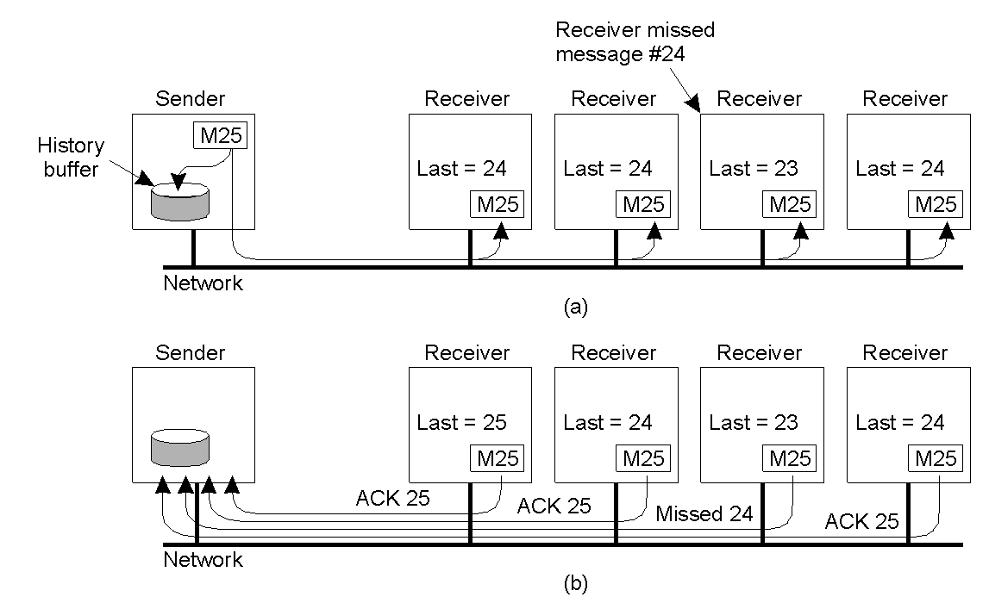
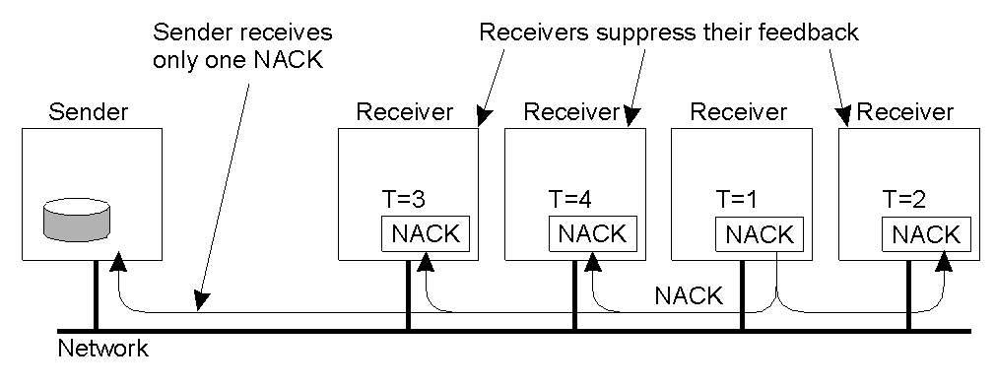
Reliable One-Many Communication
Reliable multicast
  Lost messages => need to retransmit
Possibilities
  ACK-based schemes
    Sender can become bottleneck- feedback implosion
  NACK-based schemes
  Feedback suppression

Slide 32
NACK based approach
Receiver sends feedback only for missing message
Issues:
  Sender is not aware of message having been delivered to entire group
  Sender forced to keep transmitted messages in buffer “forever” to resolve retransmission requests

Slide 33
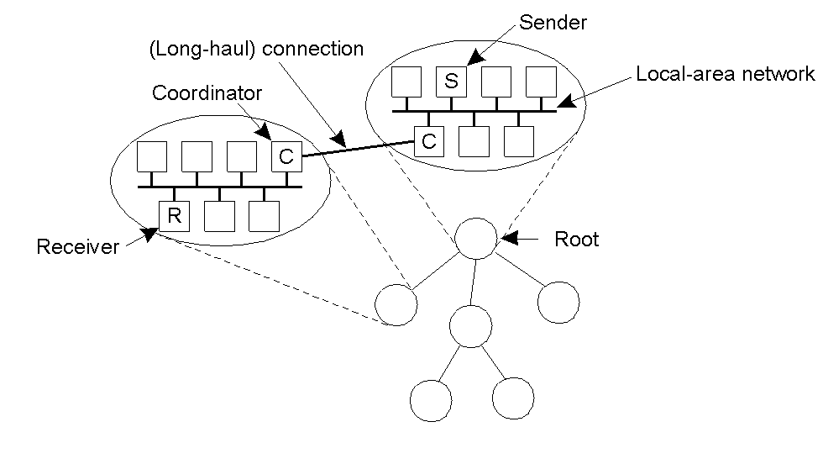
Hierarchical Feedback Control
The essence of hierarchical reliable multicasting (best for large process groups.
Each local coordinator forwards the message to its children.
A local coordinator handles retransmission requests.

Slide 34
Atomic multicast:
RELIABLE MULTICASTING IN PRESENCE OF FAILURES:
When a message is sent to the group, all members of the group receive the message. Otherwise, no member receives the message. i.e., there is never the case that some members receive the message while others do not. It is all (member) or none.

Slide 35
Atomic multicast:
Example in which atomicity is needed:
Replicated database is constructed as a group of processes, one process for each replica.
Replicated data update.
If not, the replicated data may get out of steps with each other.
Example in which atomicity is not needed:
- Locating objects in distributed service. It is sufficient that the
server holding the object receives the message. If the message
to this server is lost, the client can try again (say on time-out).
- Multiple notification in a flight information display system

Slide 36
Atomic Multicast
Atomic multicast: a guarantee that all process received the message or none at all
Problem: how to handle process crashes?
Solution: group view
  Each message is uniquely associated with a group of processes
    View of the process group when message was sent
    All processes in the group should have the same view (and agree on it)

Slide 37
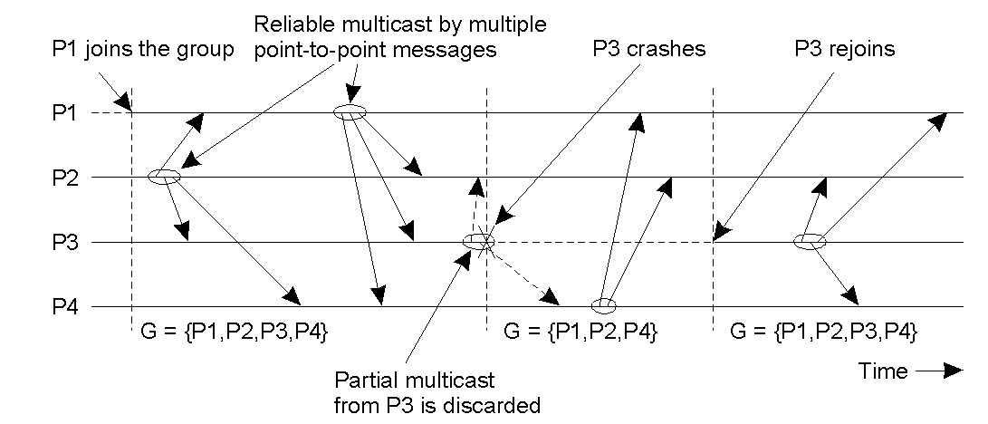
Virtual Synchrony
Virtual Synchrony guarantees that a message sent to a group view is delivered to each non-faulty member of the group.
If the sender crashes, the message may be either delivered to all the other processes or ignored by each of them.
The principle of virtual synchronous multicast (view change similar to synchronization variable)

Slide 38
Message Ordering
Four different type of ordering of multicasts:
Reliable, unordered multicast
no guarantees is given on the order in which messages are delivered
FIFO ordered multicast
messages from the same process are delivered in the order as they are sent
Causally ordered multicast
causality between messages is preserved
Totally-ordered multicast
messages are delivered in the same order to all members of the group
Virtually synchronous reliable multicasting offering totally ordered delivery is called atomic multicasting

Slide 39
Message Ordering
Process P1 | Process P2 | Process P3
sends m1 | receives m1 | receives m2
sends m2 | receives m2 | receives m1
Unordered multicast:
Three communicating processes in the same group. The ordering of events per process is shown along the vertical axis.
Process P1 | Process P2 | Process P3 | Process P4
sends m1 | receives m1 | receives m3 | sends m3
sends m2 | receives m3 | receives m1 | sends m4
 | receives m2 | receives m2
 | receives m4 | receives m4
Four processes in the same group with two different senders, and a possible delivery order of messages under FIFO-ordered multicasting

Slide 40
--P1: m0, m1, m2
– P2: m3, m4, m5
– P3: m6, m7, m8
• FIFO? (m0, m3, m6, m1, m4, m7, m2, m5, m8)
• FIFO? (m0, m4, m6, m1, m3, m7, m2, m5, m8)

Slide 41
– P1: m0, m1, m2
– P2: m3, m4, m5
– P3: m6, m7, m8
– Cross-process happened-before: m0 → m4, m5 → m8
Causal? (m0, m3, m6, m1, m4, m7, m2, m5, m8)
• Causal? (m0, m4, m1, m7, m3, m6, m2, m5, m8)

Slide 42
– P1: m0, m1, m2
– P2: m3, m4, m5
– P3: m6, m7, m8
• Total?
– P1: m7, m1, m2, m4, m5, m3, m6, m0, m8
– P2: m7, m1, m2, m4, m5, m3, m6, m0, m8
– P3: m7, m1, m2, m4, m5, m3, m6, m0, m8
• Total?
– P1: m7, m1, m2, m4, m5, m3, m6, m0, m8
– P2: m7, m2, m1, m4, m5, m3, m6, m0, m8
– P3: m7, m1, m2, m4, m5, m3, m6, m8, m0

Slide 43
Does FIFO ordered multicast imply causally ordered multicast?
Does total ordered multicast imply FIFO ordered multicast?

Slide 44
Fault Tolerance
Reliable Client-Server Communication

Slide 45
Reliable One-One Communication
  Earlier only Process failure considered,
  Need to consider communication failures too.
  Focus is on masking crashes and omission failures.
  Use reliable transport protocols (TCP) or handle at the application layer
  TCP masks omission failures (lost messages etc.) by ACKs and Retransmissions
  Crash Failure: when connection is abruptly broken ( no more msgs can be transmitted through the channel)
  Client informed by raising exceptions
  Only way to mask: set up a new connection

Slide 46
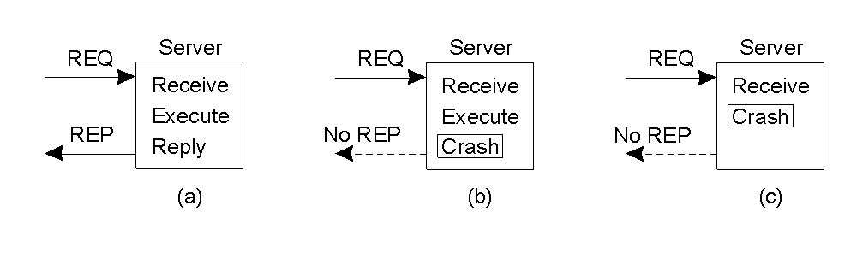
RPC semantics in the presence of failures ( make RPCs look like local ones), otherwise..
Possibilities
  Client unable to locate server
  Lost request messages
  Server crashes after receiving request
  Lost reply messages
  Client crashes after sending request

Slide 47
For each of the following applications, at-least once semantics or at-most once semantics is better?
Reading and writing files from a server
Compiling a program
Remote banking

Slide 48
In a system where the client communicates with the server over an RPC, the client keeps sending a request (say operation x()) to the server until the server responds with the result of the request.
What RPC failure semantics is being implemented in this case?
How may the client and server be implemented to achieve this semantics

Slide 49
Fault Tolerance
Recovery

Slide 50
Recovery
What happens after a fault has occurred ?
A process that exhibits a failure has to be able to recover to a correct state
There are two basic types of recovery:
  Backward Recovery
  Forward Recovery

Slide 51
Backward Recovery
The goal of backward recovery is to bring the system from an erroneous state back to a prior correct state
The state of the system must be recorded - checkpointed - from time to time, and then restored when things go wrong
Examples
  Reliable communication through packet retransmission

Slide 52
Forward Recovery
The goal of forward recovery is to bring a system from an erroneous state to a correct new state (not a previous state)
Examples:
  When a lost/damaged packet can be reconstructed as a result of the receipt of other successfully delivered packets, then this is known as Erasure Correction. This is an example of a forward recovery technique

Slide 53
More on Backward Recovery
Backward recovery is far more widely applied
The goal of backward recovery is to bring the system from an erroneous state back to a prior correct state
But, how to get a prior correct state?
  Checkpointing:
    Periodically checkpoint state
    Upon a crash roll back to a previous checkpoint with a consistent state

Slide 54
Checkpointing
Related to checkpointing are the global state and the distributed snapshot algorithm

Slide 55
Determining Global States
The global state of a distributed computation is
  the set of local states of all individual processes involved in the computation
  +
  the states of the communication channels
How?

Slide 56
Global State
We cannot determine the exact global state of the system, but we can record a snapshot of it
Distributed Snapshot: a state the system might have been in [Chandy and Lamport]

Slide 57
A naïve snapshot algorithm
Processes record their states at any arbitrary points
A designated process collects these states
+ So simple!!
- Correct??

Slide 58
Example
Producer Consumer problem
p
q
m
p records its state

Slide 59
Example
p
q
m

Slide 60
Example
p
q
m
q records its state

Slide 61
Example
The recorded state
p
q
m
m
The sender has no record of the sending
The receiver has the record of the receipt

Slide 62
What’s Wrong?
p
m
q
Result:
  Global state has record of the receive event but no send event violating the happens-before concept!!
An orphan message is a message whose receiving event is recorded in the checkpoint, but its sending event is lost.

Slide 63
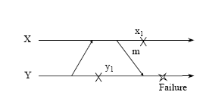
Lost Messages
A message whose sending event is recorded, but its receiving event is not recorded.

Slide 64
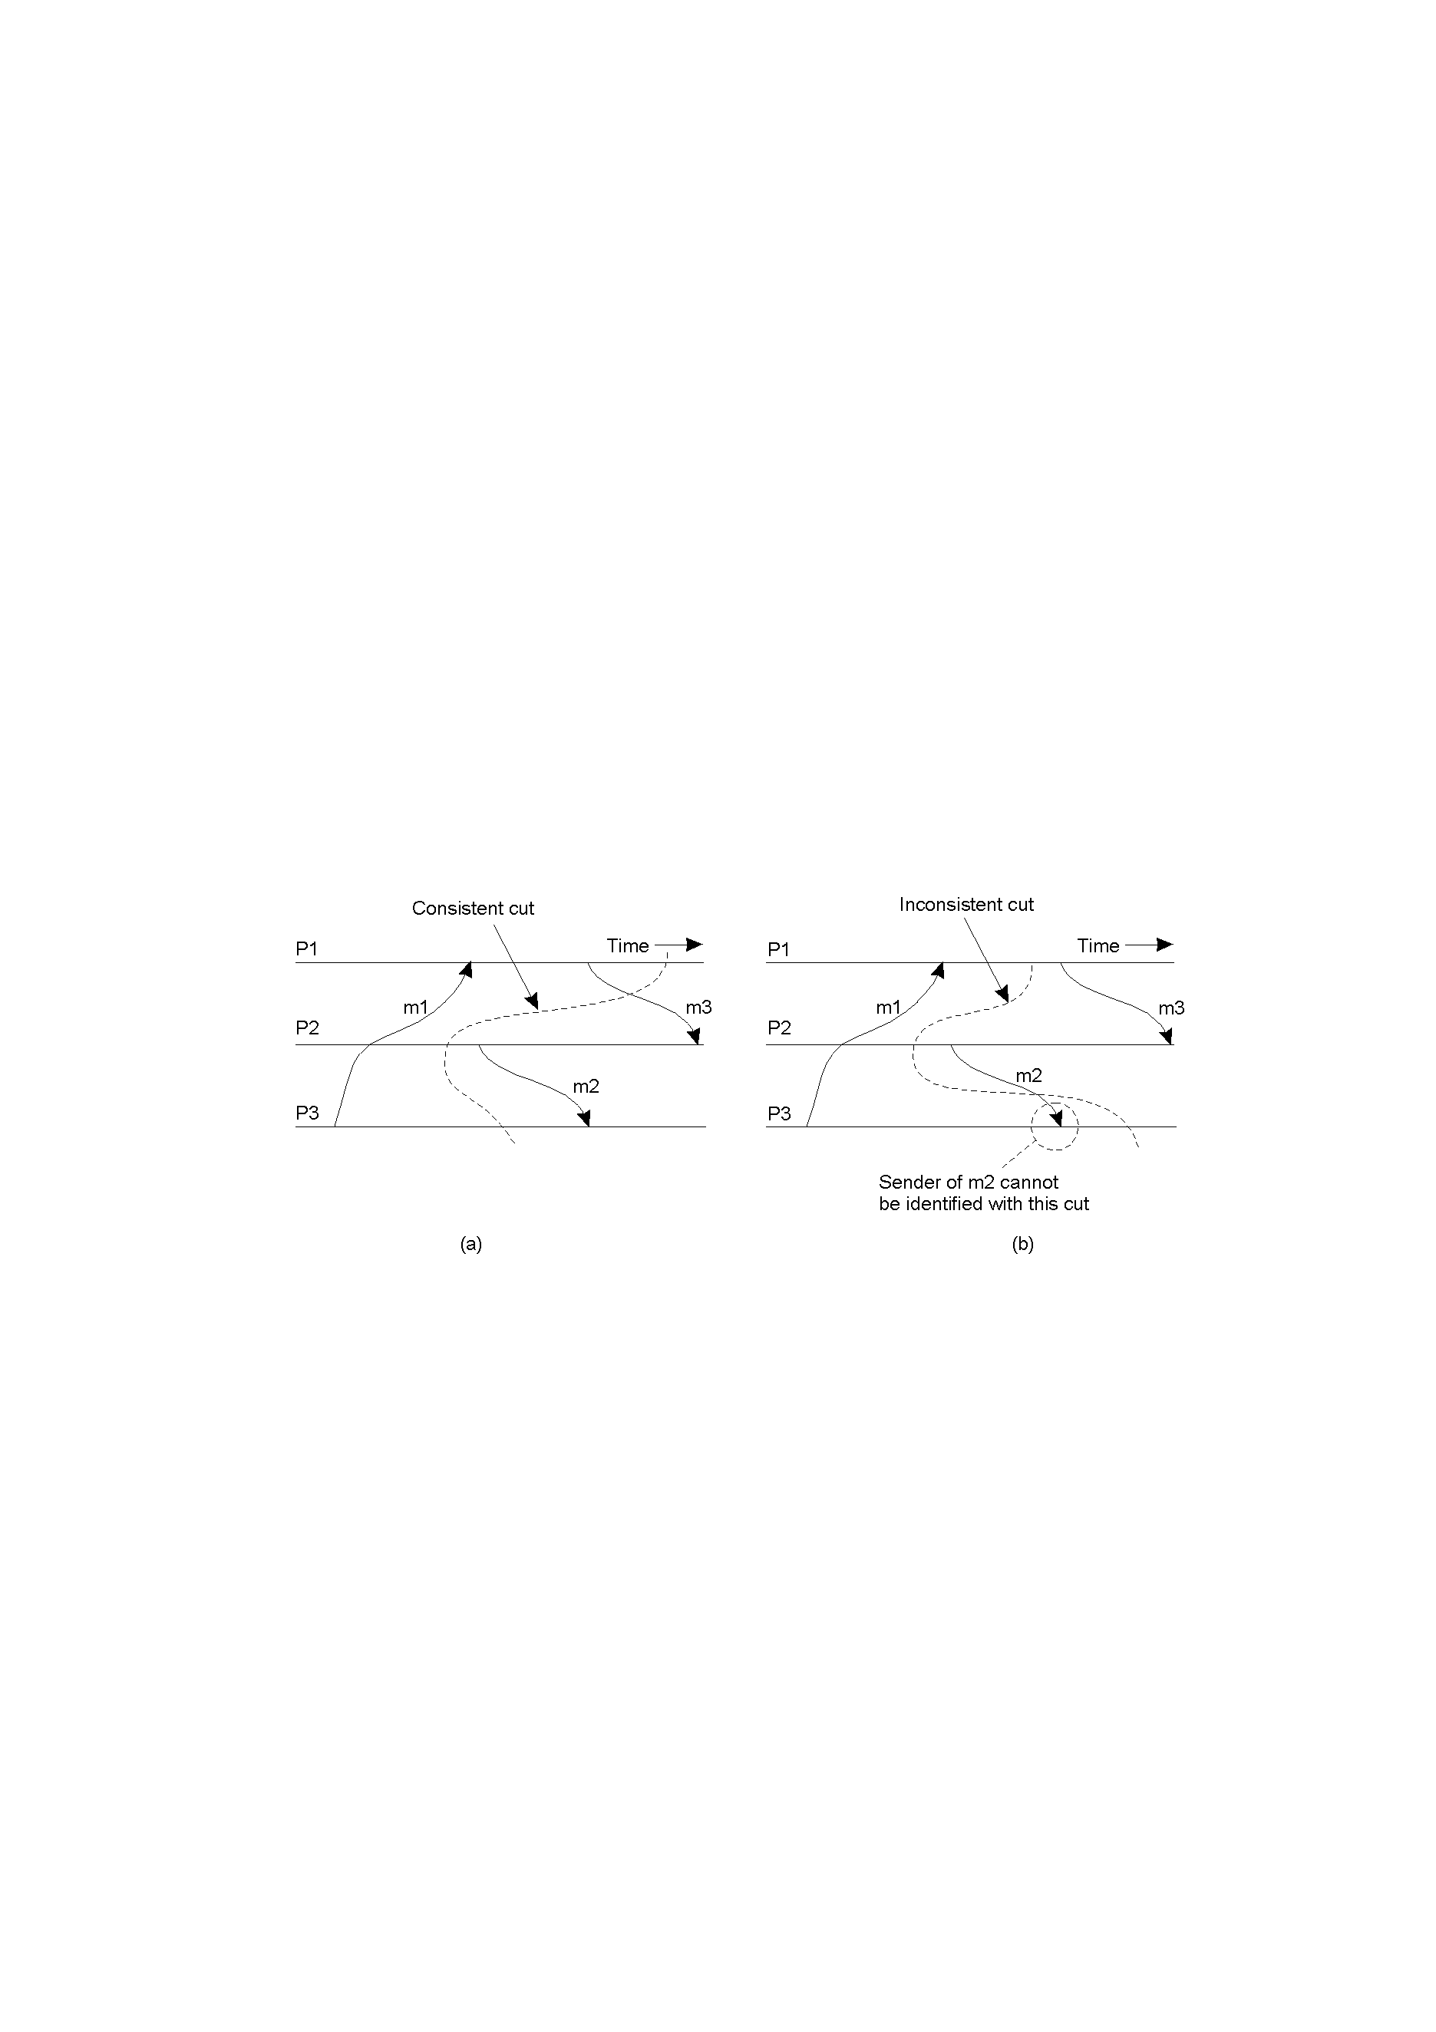
Cut
A consistent cut (meaningful global state) ?

Slide 65
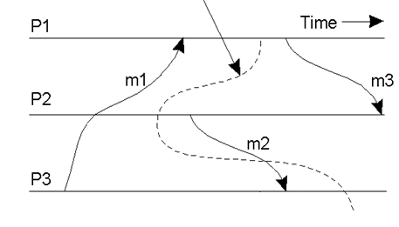
Cut
A consistent cut (meaningful global state) ?

Slide 66
Cuts
A consistent cut (meaningful global state)
An inconsistent cut

Slide 67
Consistent Checkpoints
A process saves its local state on the stable storage, which is called a local checkpoint.
The process of saving local states is called local checkpointing.
All the local checkpoints, one from each site, collectively form a global checkpoint.
A global checkpoint is a strongly consistent set of checkpoints if there is no orphan and no lost message.
A global checkpoint is a consistent set of checkpoints if there is no orphan message.

Slide 68
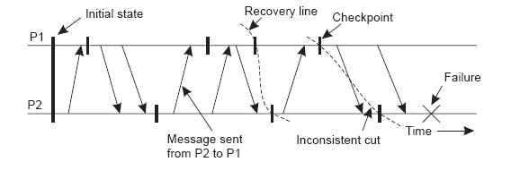
Checkpointing
The most recent distributed snapshot in a system is also called the recovery line

Slide 69
Independent Checkpointing
Each processes periodically checkpoints independently of other processes
Upon a failure, work backwards to locate a consistent cut
Problem: if most recent checkpoints form inconsistent cut, will need to keep rolling back until a consistent cut is found
Cascading rollbacks can lead to a domino effect.

Slide 70
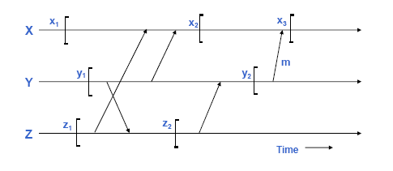

Domino Effect:

Slide 71

Domino Effect:
The domino effect is a chain reaction that occurs when a small change causes a similar change nearby, which then will cause another similar change, and so on in linear sequence. The term is best known as a mechanical effect, and is used as an analogy to a
falling row of dominoes. .......

Slide 72
Coordinated Checkpointing
To solve this problem, systems can implement coordinated checkpointing
Take a distributed snapshot
Upon a failure, roll back to the latest snapshot
  All process restart from the latest snapshot
Algorithm for distributed global snapshots is not particularly efficient for large systems
Another way to do it is to use a two-phase blocking protocol (with some coordinator) to get every process to checkpoint its local state “simultaneously”

Slide 73
Coordinated Checkpointing
Make sure that processes are synchronized when doing the checkpoint
Two-phase blocking protocol
  Coordinator multicasts CHECKPOINT_REQUEST
  Processes take local checkpoint
  Delay further sends
  Acknowledge to coordinator
  Send state
  Coordinator multicasts CHECKPOINT_DONE

Slide 74
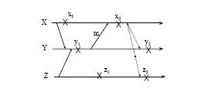
An Optimization
Sometimes, it is not necessary to ask all processes to take checkpoints for each checkpointing initiation.

Slide 75
Message Logging
Checkpointing is expensive
  All processes restart from previous consistent cut
  Taking a snapshot is expensive
  Infrequent snapshots => all computations after previous snapshot will need to be redone [wasteful]
Combine checkpointing (expensive) with message logging (cheap)
  Take infrequent checkpoints
  Log all messages between checkpoints to local stable storage
  To recover: simply replay messages from previous checkpoint
    Avoids recomputations from previous checkpoint

Slide 76
Message Logging
Message-logging schemes can be characterized as pessimistic or optimistic
Pessimistic message logging: an incoming message is logged before it is processed.
  Two much overhead, and
  slows down computation
Optimistic message logging : processes continue to perform the computation, and store messages in memory, which will be logged at certain intervals.
  More rollbacks during failure,
  may still have domino effects.

Slide 77
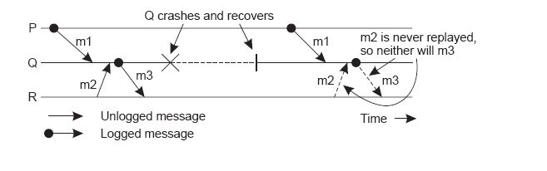
Message Logging
An example of an incorrect replay of messages

